Slide 1
Section 6.1
Simulations and Probability Experiments

Slide 2
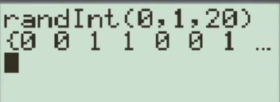
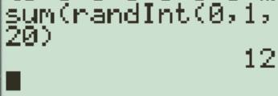

What is a Simulation?
A simulation is a probability activity that is used to mimic and calculate the probability of a real life scenario → help us to understand what outcomes are “normal” or “reasonable”
Ex: Suppose we are to flip a coin 20 times, how many of these flips will be heads? If we do this many times, what outcomes are “normal”?
Rather than flipping a coin 20 times a thousand times, we can run a simulation using a random number generator to repeat this many times
We pick 20 numbers from zero to one. Ie: Zero (tails) and heads are one
Simulations can be used to repeat an experiment many times to create a distribution to help us see what outcomes are likely to occur and which ones are “unlikely”
We can also use the “sum” function in the beginning to tally the number of heads
On the next slide, a coin is flipped 10 times and the number of heads/tails are recorded. The simulation is ran 1000 times, the probability distribution is provided:
With this number generator, we can simulate 20 flips of a coin many many times

Slide 3
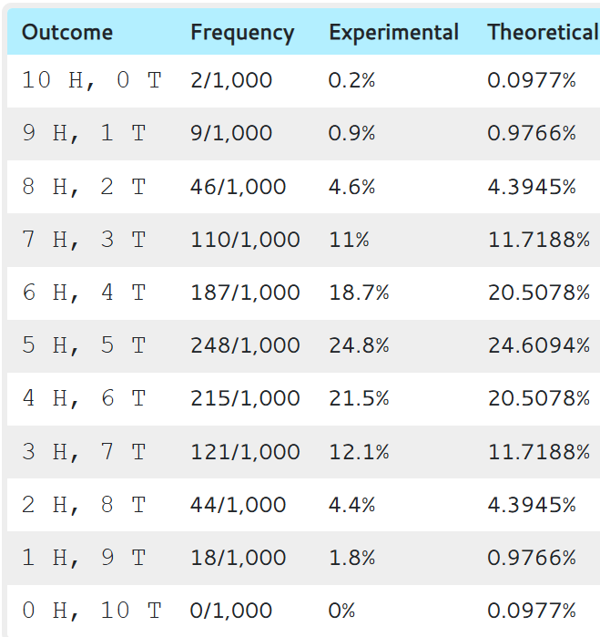
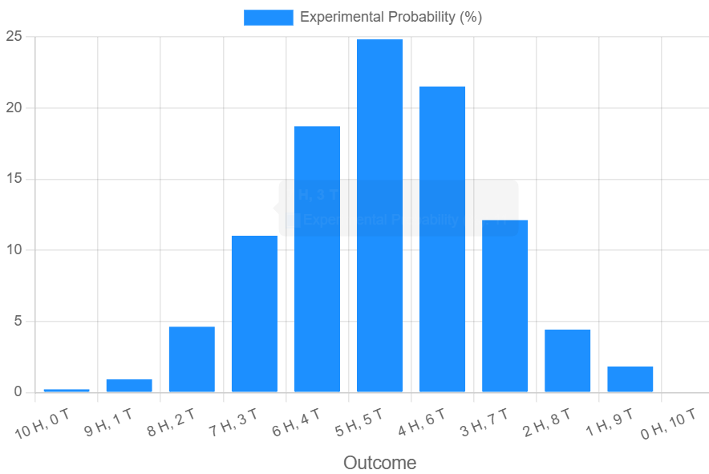
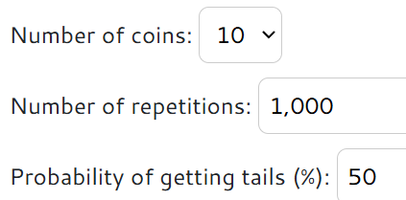
HOW to Use the rEsults of Your simulation:
Website on simulating 10 coin flips
https://www.mathmammoth.com/practice/coin-tosser

Slide 4
Q: From the simulation, what is the probability of getting exactly 5H/5T?
Q: What is the probability of getting at least 7H?
Q: Approximately what percentage of results are between 3 to 7 H?
Q: We are given that the coin flipped is a fair coin, what is the probability of getting either 10 Heads or Zero Heads?

Slide 5
Variation in Experimental Outcomes:
Variation can occur in
1. The outcomes of a single trial: From 0 Heads to 10 Heads
  Any outcome from 0 heads to 10 heads are all possible
  Keep in mind that some outcomes are more likely to occur than others
2. The distribution of our experimental outcomes
  If we run our simulation of 1000 trials of 10 flips, the distribution on these outcomes will vary slightly
  If we increase our number of simulations, the distribution will become more like the distribution of theoretical probability
  Ch 6 and 8 will focus on calculating the mean, standard deviation, variance of theoretical probability distributions

Slide 6
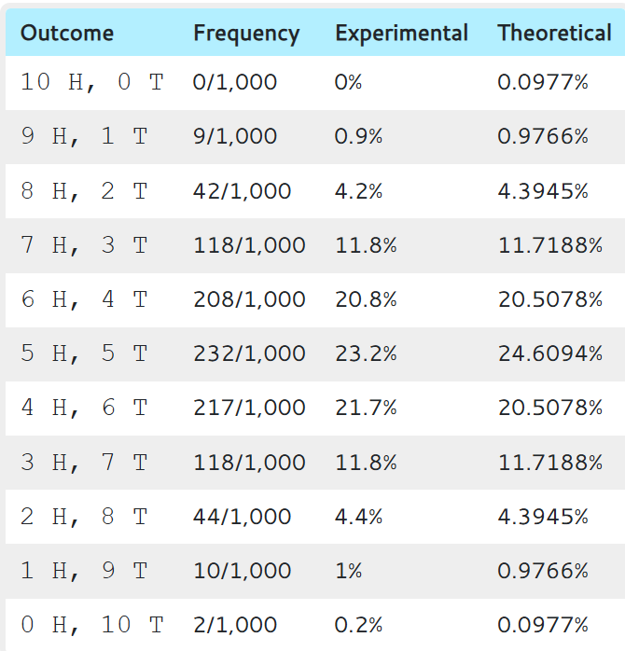
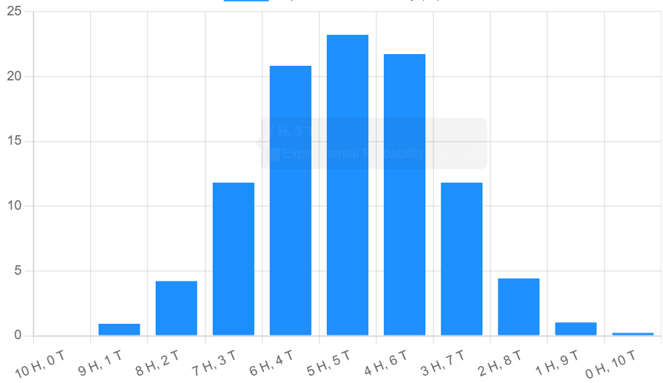
Here are two examples of 1000 simulations of 10 coin flips
The distributions are slightly different

Slide 8
Q: Suppose you flipped a coin 10 times and got 10 heads in a row. Which of the following statements is correct?
a) The coin must be a bias coin since it is unlikely to get 10 heads in 10 flips
B/c of variation, any outcome from 0 to 10H is possible. Although the probability of getting 10H is small, we can not conclude the coin is not fair based on only one simulation.
b) If the coin is fair, the probability of getting 10 heads in 10 flips would be very low. Therefore, this is evidence to suggest that the coin is not fair
This statement is true. Your results provide strong evidence, not a conclusion

Slide 9
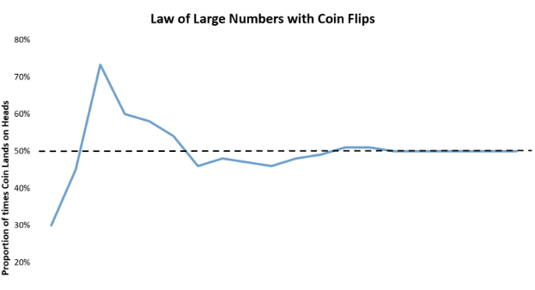
LAW of Large Numbers

Slide 10


Designing a simulation with Number Generators:
To design a simulation, we need to know the probability ratios between success and failure
Ie: when flipping a coin, only 2 outcomes: 0-tails and 1-heads [2 numbers]
The probability of scoring a 3 point shot is 33.333%: (1/3): [3 numbers]
3 numbers, 0 and 1 are failure, 2 is success
The probability that a girl will say yes when Alec’s asks them on a date is
1 out of 1000:
1000 numbers, 001 to 999 are NO’s and 000 is yes
The probability that someone will drop out of AP statistics next week is 8%
100 numbers, 00 to 07 YES, 08 to 99 are NO’s

Slide 11
What is Important?
Simulations are used to model probability events
  “If it’s too hard to calculate the probabilities, use simulations”
the probability ratios of a simulation should reflect the ratios of success to failure of the real event
  For instance, Bob is racing Andy. Bob is twice as likely to win. So we would use numbers to simulate the race. Digits 1, 2, 3, 4, 5, 6 represents Bob winning. 7, 8, 9 represents Andy winning.
Simulations are to be done many times, to see what outcomes are likely to happen
  Suppose Andy and Bob races 10 times, how many times would Andy win?
  We would perform a thousand simulations of these 10 races, 95% of our results show that Andy would win between 2 to 6 races.
  Suppose Andy claims that he is a faster runner. With our simulation, we can argue against this claim since he will lose almost 95% of the time

Slide 12
HOW to TEST if a Claim is TRUE or Unlikely to be TRUE?
Simulations can be used to make an argument:
1. We assume that “A” is true.
2. We then perform an experiment and get a particular result
3. Use simulations to calculate that the probability of getting our results if “A” was true [conditional probability]
4. If our simulations show that getting these results are very unlikely if “A” is true, then two things can happen:
A) “A” is true → these results are false (unlikely to happen)
B) these results are true [b/c they occurred] → then it is unlikely that “A” is true
If an event occurred that is unlikely to happen if “A” were true, then this is evidence that “A” is likely false.

Slide 13
Designing Simulations:
Explain how you will assign numbers with a random generator to simulate each of the following events:
i) Jim is a 75% free throw shooter. How many shots will he make if he takes 25 free throws
ii) Two different schools graduated 25 bus drivers each. 8 from school A were accident free in their first year vs 15 from school B. Is school “B” better?
iii) In the game of “RISK”, an attacker rolls 3 dice vs a defender with 2 dice. The attacker uses it’s 2 highest rolls. The defender wins if their role is equal or higher. What is the likelihood that an attacker will win each attack?

Slide 14

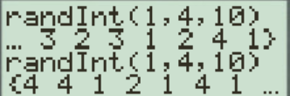

i) Jim is a 75% free throw shooter. How many shots will he make if he takes 25 free throws
Use a random number generator using only numbers between 1 to 4, inclusive. Numbers 1, 2, and 3 are made baskets. Number 4 is a missed basket. Use the number generator to get 25 numbers. Count how many 1, 2, and 3’s there are to simulate the number of made baskets.
ii) Two different schools graduated 25 bus drivers each. 8 from school A were accident free in their first year vs 15 from school B. Is school “B” better?
There are 50 drivers in total and 23 were accident free. Numbers 1 to 50 for each driver and 1 to 23 are the accident free “good” drivers. Use a random generator to select first unrepeated 25 drivers for school “A” and the next for school “B”. Simulate if school “B” got lucky with more good drivers than school “A”.

Slide 15
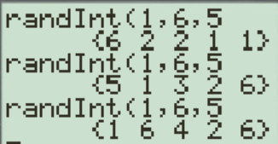
iii) In the game of “RISK”, an attacker rolls 3 dice vs a defender with 2 dice. The attacker uses it’s 2 highest rolls. The defender wins if their role is equal or higher. What is the likelihood that an attacker will win each attack?
Use only numbers from 1 to 6 and select 5 numbers for each trial. The first 3 numbers represent the rolls of the attacker and the other 2 for the defender.

Slide 16

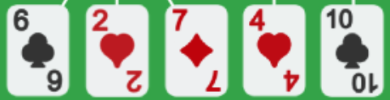

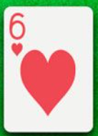
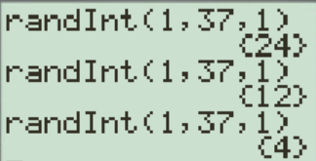
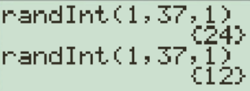



iv) In Texas Holdem, you have pocket hearts and two hearts are flopped. How likely is the river card also a heart? 4 players.
?
52 cards and 13 hearts in total. 1 to 52 represent each card. 6 cards are “known” and 4 of them are hearts. 9 cards are either “burnt” or belong to the other players. Numbers 1 to 9 represent the hearts remaining. Do a simulation for the number of hearts already taken or burnt. Then do another simulation for the river card depending on how many hearts are left.

Slide 17
Key Ideas:
Statistical results are often used as evidence to support an argument or agenda
Ie: Can dolphins talk to each other? An experiment of 10 trials was conducted and 9/10 trials supported this conjecture
Does majority (60%+) of population prefer private health care? In a sample of 300, 160 people said yes?
In an alternative study, on whether majority (60%+) of population prefer private health care, a sample of 300 had 30 people said yes?
When we look at these statistical results, do they provide enough evidence for the conjecture that is being argued for?
OR do these results occur only by chance/variation and the conjecture is not true
NOTE: for each experiment, identify the conjecture

Slide 18


An experiment was conducted by the Univ. of Florida to test if bottlenose dolphins can communicate with each other. Two dolphins in separate tanks have two buttons each. If the two dolphins press the same button, they were rewarded with a snack. Out of 10 trials, the dolphins were successful 9 times. Would this experiment be conclusive evidence that dolphins can communicate with each other?
Conjecture: Can dolphins actually communicate with each other???
Counter Argument: If dolphins can not communicate with each other, then the probability of success of each trial would be 50%
Q: Can the results of this experiment be due to “LUCK”.
Ie: Dolphins were lucky?
Suppose the dolphins were actually just lucky, what is the possibility that they would get 9 out of 10?
This is where “statistical simulations” come into play
We would conduct multiple simulations on getting a result of 9 or more out of 10 “IF” dolphins don’t communicate
If dolphins DON”T communicate, then probability of success would be 50%
Conduct a simulation with two equal outcomes, and see if 9/10 would occur because of “VARIATION”

Slide 19
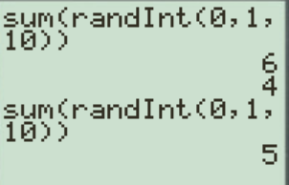
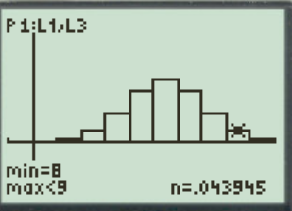
SIMULATION:
1. Assignment: We would assign two numbers, zero is failure and 1 is success
2. Trial: Conduct this trial 10 times. Use randint(0,1,10) to generate a list of 10 numbers of zeroes and ones. OR better yet, use SUM(randint(0,1,10), counts the number of success for you
On a Ti-83, use the SUM & RandInt commands to generate a coin flipping simulation:
The sum would be the number of “heads” in your simulation
3. Repetition: Repeat this simulation multiple times, many times. The repetitions allow you to see the distribution of responses. Note: The distribution will be a “normal distribution”
Theoretical distribution of the outcomes based on a binomial distribution
The probability of exactly 9/10 success “P(x=9)” from a single trial would be 0.04395%. P(x=10) = 0.009765.

Slide 20
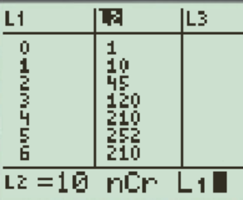
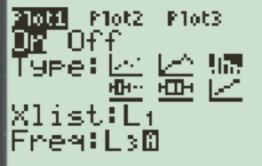

Q: Can these results be obtained by chance/variation?
Getting 9 out of 10 attempts is possible but the probability is low. Due to variation, any possibility can occur
If the DOLPHINs CAN NOT communicate, the probability that they will get 9 out of 10 correct is around 4.39%. The probability of getting “atleast” 9 out of 10 [9H or 10H] is around 5% [1 out of 20]
Since this probability is quite low, it is evidence to suggest that our claim [Dolphins can not communicate] may not be true

Slide 21
How to create a Simulation:
Start off with a conjecture and the experimental results to support it
Looking at the context of the experiment, we would create a scenario FOR of AGAINST the conjecture
  Ie: if dolphins can talk to each other, the chances of success would be 50/50
Assume the conjecture to be “TRUE” or “False” and then come up with the probability ratios
  YES 50% vs NO 50% → Dice
  Majority YES (60%) vs Minority (40%) → Digits 0 to 9, random digits
Create an activity that will reflect these probability ratios
  Flip Coin - 2 outcomes 50/50
  Rolle Dice – 6 outcomes, 3 outcomes, or 2 outcomes
  Random digits – 10 outcomes
  Double digits assignment

Slide 22
Coin flipping Simulation:
When you flip a coin 10 times, any event is possible
Getting zero to 10 heads are all possible outcomes, except some outcomes are more/less likely to occur than others
To simulate flipping 10 coins, use Ti83 “MATH” “PRB”,
RandInt(0,1,10) where 0 (tails) and 1(heads)
sum(randint(0,1,10) – counts the number of 1(heads) for you
Activity: Flip a coin 10 times, record the number of heads that appear. Repeat this trial 10 times. Record your results on the board with the class
Q: Did any extreme cases occur? What percentage?
Q: Did anyone get 10 heads or 0 heads in any trial?
Q: What about 9 heads or only 1 head?

Slide 23
Simulation
“The imitation of chance behaviour, based on a model that accurately reflects the experiment under consideration is called a simulation.” (Yates & Moores)
Using a probability model or experiment to imitate an actual phenomenon
Ie: events with two outcomes, each is 50% → Flip a coin
Events where one outcome is 25% other is 75% → Flip two coins (HH, HT, TH event A) and then (TT) event B
Q: How would you simulate each of the following?
i) Event A is 80% and Event B is 20%
ii) 3 outcomes (A,B,C), each are equally likely. How many trials do you need until event A occurs?
iii) Steph Curry has a 45% 3 pt average taking 10 3’s a game. What is the probability that he will make 7 or more 3 pt. shot?

Slide 24
Q: How would you simulate each of the following?
i) Event A is 80% and Event B is 20%
ii) 3 outcomes (A,B,C), each are equally likely. How many trials do you need until event A occurs?
iii) Steph Curry has a 45% 3 pt average taking 10 3’s a game. What is the probability that he will make 7 or more 3 pt. shot?
A: 1, 2, 3, 4 B: 5 randint(1,5,n)
Five cards: 4 of them represents “A”, 1 of them represents “B”
Roll dice: A: 1 – 4, B: 5, and 6 is omitted
A: 1, B: 2, C: 3 randint(1,3,n)
Roll dice: A - 1,2 , B- 3, 4 C- 5,6
Use 3 cards…..
A: 1, 2, 3, 4, 5, 6, 7, 8, 9 (45%) B: 10, 11, 12, 13, 14, 15, 16, 17, 18, 19, 20 (55%) randint(1,20,10)

Slide 25
On January 1, 2010 BC banned the use of cell phones while driving. This was improve road safety and prevent drivers from being distracted.
Many studies were done to show that the use of cell phones increased the risk of accidents.
Redelmeier and Tibshirani (1997) – cellphone drivers 4 times more likely to be in an accident
University of Utah (2001): cellphone/handsfree – significant cognitive distraction, longer reaction time, missed exits,
Virginia Tech Transportation Institute (2009): - texting increased the risk of “collision” and “near collision” by 23 times
Another study is the “Passenger” vs “cell phone” study:
Q: Is talking on a cell phone more distracting than talking to a passenger?

Slide 26
Activity: “Distracted Driving”
Which is more distracting for drivers??
  Cell Phones VS Talking to a Passenger?
In a study of 48 people, 24 were randomly assigned to drive in a driving simulator while using a cell phone. The other 24 were assigned to drive in the simulator while talking to a passenger. All drivers were asked to exit the highway in the simulator.
Goal: See which group had more drivers miss their exit b/c of the distraction.
RESULTS: In the study, 7 of the 24 cell phone users missed the exit, while 2 of the 24 drivers talking to a passenger group missed the exit.
It was then concluded that cell phones are more than 3 times more distracting than a passenger
Q: Are these conclusions correct? What else could have accounted for the difference in results?
Group1
24 subjects
Cell Phone
7/24 missed exit
Random
Allocation
of 48 subjects
Compare
Results
Group 2
24 subjects
Passenger
2/24 missed exit

Slide 27

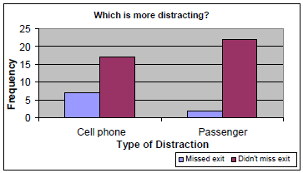
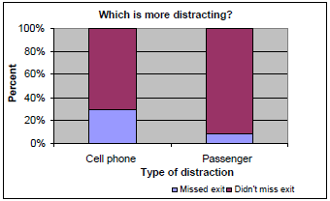
HOW the RESULTS were USED to support that Cell Phones were more distracting than talking to a passenger
7
29.1%
2
8.3%
17
70.8%
22
91.7%
Q: Are all drivers equally skilled?
Is it likely that more bad drivers ended up one group due to variation?

Slide 28
Q: Is it correct to conclude that cell phones are more distracting than passengers?
Q: What assumptions about the drivers that we made could be incorrect? Explain:
Q: Is there a simulation that we can design to test our results? Can you design such a simulation?
Q: In your group, perform your simulations 50 times each. Use the results from your simulation to test the results of the experiment? Interpret your results.

Slide 29
It is possible that some of the drivers are good and some are bad.
We can not make the assumption that all the drivers are equal.
In total, 9 drivers missed their exits, so 9 of them are bad drivers. The rest that made the exit are good drivers (39)
Q: Is it possible that the cell phone group were randomly given 7 out of the 9 bad drivers?
SIMULATION:
Random Number Generator:
Deck of Cards
48 drivers – numbers 01 to 48
BAD Drivers – numbers 01 to 09
Good Drivers – 10 to 48
Randomly generate 24 numbers to be in cell phone group
(skip repeats)
Use 48 cards, assign 9 cards to be bad drivers, 39 good
Deal the deck of 48 cards into two piles
Count the number of bad drivers in the cell phone pile

Slide 30
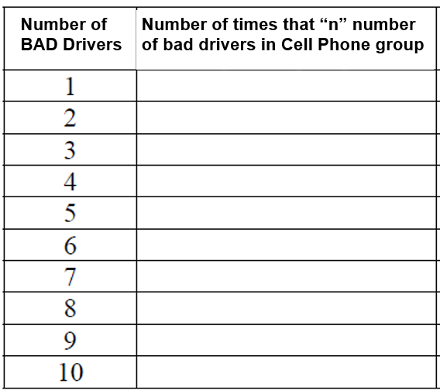
Perform 10 simulations each, tally your results onto this chart
Use the results on this chart to create a histogram
According to your simulations, what is the probability of assigning 7 or more bad drivers into the cell phone group?
Are these results significant enough to reject the claim that cell phones are more distracting than a passenger?

Slide 31
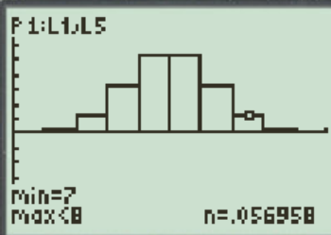
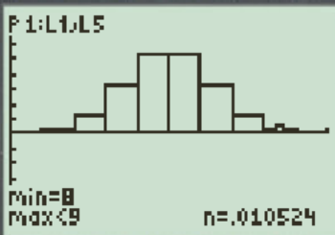
48 drivers – numbers 01 to 48
9 drivers missed the exit (bad drivers) – numbers 01 to 09
Randomly select 24 drivers into the cell phone group
Randomint(1,48,48) – select the first 24 drivers, skip repeats
For each simulation, count the number of bad drivers in the cell phone group
Ie: Out of 50 simulations, how many of them had 7 or more bad drivers in the cell phone group?

Slide 32
Almost 7% of our simulations, where the cell phone group had 7 or more bad drivers.
Which means, there is a good chance that the bad drivers were just assigned to the cell phone group, rather than the cell phone being more distracted.

Slide 33

BAD Drivers Video!

Slide 34
Main Ideas!!
You always begin with a conjecture, ie: dolphins can communicate, eating beef increases pregnancies with boys, ….etc..
These propositions will be tested in a proper experiment, the experiment will generate a percentage of success, results
Your main question then becomes: Is it likely that these results can occur by variation/chance IF our conjecture was not true?
So we create our simulation assuming the conjecture to be false, [things are 50/50]
Simulate “n” trials, look at how many of our trials gave the same results
Ie: we did 100 trials and with variation, only 2% of our trials gave the same results. Does this give evidence “FOR” or “AGAINST” our conjecture?
Answer: Anything that is 5% or less is evidence “FOR” our conjecture
If the likelihood of the results are very low, then it’s likely that the results DID NOT happen by chance and there’s a high probability that the proposition is true
This is what chapters 9 to 10 will focus on!!!

Slide 35
Ex: A basketball player makes 70% of her free throws in a long seasons. In a tournament game she shoots 5 free throws late in the game and miss 3 of them. The fans think that she is nervous, but the misses may simply be chance. You will shed some light by estimating the probability.
A). Describe how to simulate a single shot if the probability of making each shot is 0.7. Then describe how to simulate 5 independent shots.
Assign 1 – 7 “hit” and 8 -10 “misses” OR
0 – 6 “hit” and 7 – 9 “misses”. Which one is better?
B). Simulate 50 repetitions of the 5 shots and record the number missed on each repetition. Use Table B starting at line 125. What is the approximate likelihood that the player will miss 3 or more shots?
C) What conclusions can you make from your simulation?

Slide 36
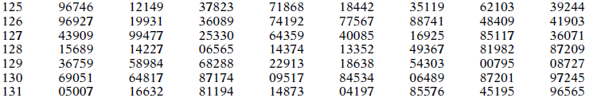
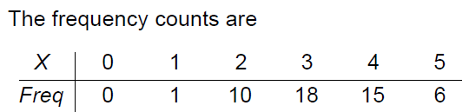
The relative frequency of missing 3 or more shots is 11/50
The probability of a 70% shooter missing 3 out of 5 shots from our simulation is 22% (quite a high probability)
Conclusion: It is likely that the basketball player is a good shooter but is having a bad shooting day

Slide 37
Ex: Describe how you would create a simulation for each of the following experiments. Do the results of the study support the proposition? Explain:
i) Does eating beef increase chance of having boys in pregnancy? A group of 22 pregnant mothers were given a high beef diet. In the study, 17 of the moms gave birth to boys.
ii) It is estimated that 1 in 5 males is colour blind. A small city is suing a factory for pollutants in water that could be causing children to be born with defects. Last year, 20 boys were born in the city, 8 are detected to be color blind.
iii) Fluorescent vs UV lights for growing plants. 20 plants were randomly assigned to be treated with each light over winter. 2 vs 6 plants survived for fluorescent vs UV lights respectively. Are UV lights better for plant survival?

Slide 38
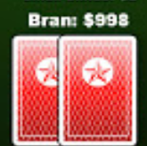
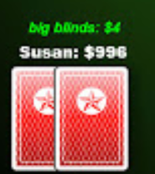

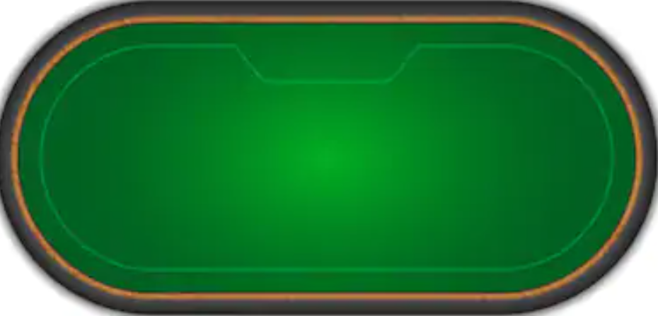
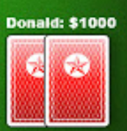


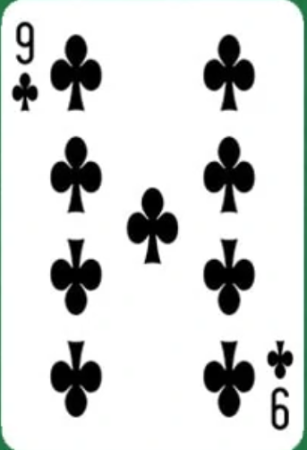

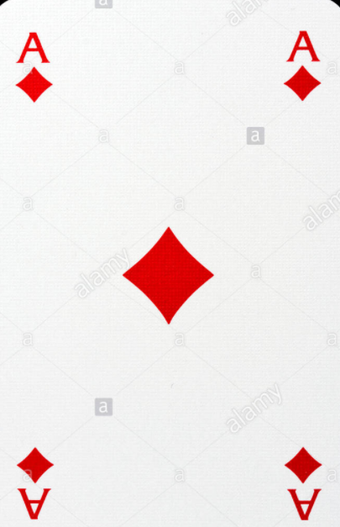
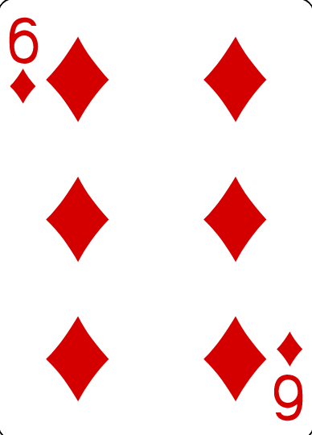
Activity: Should you chase the River?
4 players, each have two cards
3 cards are burnt (discarded), 4 cards are revealed
You have a potential flush, should you play?
Design an activity to simulate this event using random digits

Slide 39
How to simulate this event:
Use a two digit number to represent each card:
  Hearts: 10, 11, 12, 13, 14, 15, 16, 17, 18, 19, 20 , 21, 22 to represent all the hearts from Ace, 2, 3, …. King
  Diamonds: 30, 31, 32, 33, 34, 35, 36, 37, 38, 39, 40, 41, 42 to represent all the hearts
  Clubs: 50, 51, 52, 53, 54, 55, 56, 57, 58, 59, 60, 61, 62 to represent all the clubs
  Spades: 70, 71, 72, 73, 74, 75, 76, 77, 78, 79, 80, 81, 82 to represent all the spades
Since you have the ace and 6 of diamonds → 10 & 15 are scrapped, scrap also the ones that are opened [flopped]
9 unknown cards (3 burnt, 6 from players) will be scrapped before the river is revealed. So go down the random table digits and scrap the first 9 cards
The 10th card that appears will be the river. Perform this activity for 5 trials. Record. How many trials does flush appear?

Slide 40
Homework:
P397 6.1, 6.2, 6.4 6.5
P402 6.10, 6.12
P404 6.14, 6.15

Slide 41
You Are What Your Mother Eats: Evidence for Maternal Preconception Diet Influencing Foetal Sex in Humans
A 2008 study of 740 women concluded there was a higher probability of having a male baby when the mother increased her calorie intake and ate breakfast cereals. Researchers hypothesized that this may be because higher blood glucose levels favor having a boy
Fifty six per cent of women in the highest third of pre-conceptional energy intake bore boys, compared with 45% in the lowest third. Intakes during pregnancy were not associated with sex, suggesting that the foetus does not manipulate maternal diet.
https://www.researchgate.net/publication/5421539_You_Are_What_Your_Mother_Eats_Evidence_for_Maternal_Preconception_Diet_Influencing_Foetal_Sex_in_Humans
https://www.theguardian.com/science/2008/apr/23/medicalresearch.children

